Slide 1
Hash Tables

Slide 2
Concept of Hashing
In CS, a hash table, or a hash map, is a data structure that associates keys (names) with values (attributes)
Look-Up Table
Dictionary
Cache
Extended Array

Slide 3
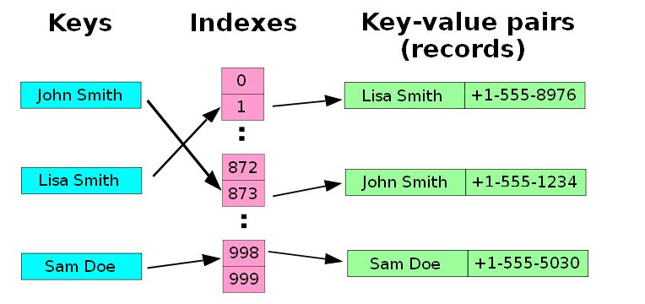
Concept of Hashing
A small phone book as a hash table
(Figure is from Wikipedia)

Slide 4
Dictionaries
Collection of pairs
(key, value)
Each pair has a unique key
Operations
Get(theKey)
Delete(theKey)
Insert(theKey, theValue)

Slide 5
Idea
Hash table :
Collection of pairs
Lookup function (Hash function)
Hash tables are often used to implement associative arrays,
Worst-case time for Get, Insert, and Delete is O(size)
Expected time is O(1)

Slide 6
Origins of the Term
The term "hash" comes by way of analogy with its standard meaning in the physical world, to "chop and mix.”
D. Knuth notes that Hans Peter Luhn of IBM appears to have been the first to use the concept, in a memo dated January 1953; the term hash came into use some ten years later.

Slide 7
Search vs. Hashing
Search tree methods: key comparisons
Time complexity: O(size) or O(log n)
Hashing methods: hash functions
Expected time: O(1)
Types
Static hashing
Dynamic hashing

Slide 8
Hashing terminology
hash table - a data structure in which the location of an object is determined by applying a function to its value.
cell or bucket - a single location in a hash table.
hashing - applying a function to the value of an object to determine a location.
perfect hash function - maps each value to a unique position or location
http://www.cs.utsa.edu/~cs2123/lectures/week14.html

Slide 9
Hashing terminology
load factor - the fraction of occupancy in a hash table before it is resized
hash key - integer value computed for an object by applying a hash function
one-way hash function - function in which given the result of hashing, it is very hard to guess anything about the original value that was hashed
collision - when two objects are mapped to the same location in a hash table

Slide 10
Hashing
The idea:
take a field in a record, known as the value,
convert it through some fixed process to a numeric value, known as the hash key
Hash key represents the position in the table
in the range of 0 to n - 1, where n is the maximum number of slots (or buckets) in the table
http://faculty.cs.niu.edu/~freedman/340/340notes/340hash.htm

Slide 11
Hashing
You add an object to a collection represented by a hash table by first computing an integer value for the object called a hash code and then inserting the object at the location specified by the hash code. Adding to a hash table is usually an O(1) operation.

Slide 12
Hashing
To remove an object from a hash table, you have to be able to give the value of the hash code. If you have it, removing an element from the hash table is usually an O(1) operation.

Slide 13
Hashing: division method
One common method of determining a hash key is the division method of hashing. The formula that will be used is:
hash key = key % number of slots in the table

Slide 14
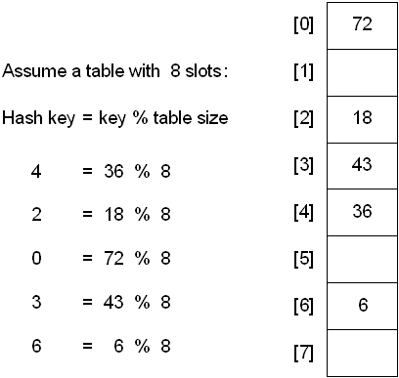
Hashing: division method

Slide 15
Hashing: division method
A reasonable strategy
The problem
Keys may have some undesirable properties
the table size is 10 and all of the keys end in zero
Solution:
The choice of hash function and table size
The best table sizes are prime numbers.

Slide 16
Hashing: division method
A reasonable strategy
The problem
Keys are not always numeric but strings
Solution:
Add up the ASCII values of the characters in the string to get a numeric value
Then perform the division method

Slide 17
Hash Collisions
Chaining (each location is a reference to a linked list)
Open addressing - look for another location if the correct one is already filled:
Linear probing - fill the first empty slot after the correct location
Quadratic probing - fill the slot computed by a quadratic function of location
Rehashing - apply a second (or even third) hash function
It is easier to remove elements with the chaining method.

Slide 18
Hash Collisions: Chaining
Chaining allows many items to exist at the same location in the hash table.
When collisions happen, the item is still placed in the proper slot of the hash table
The difficulty of searching for the item in the collection increases.

Slide 19
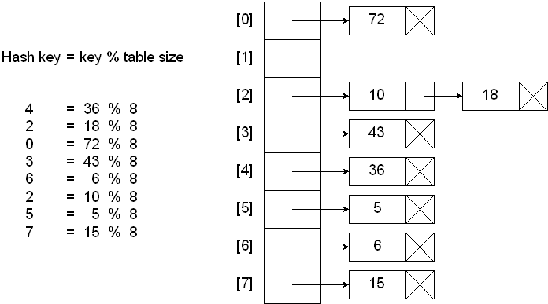
Hash Collisions : Chaining

Slide 20
Hash Collisions : Chaining
Searching a hash table with chains:
Compute the hash key
If slot at hash key is NULL
Key not found
Else
Search the chain at hash key for the desired key
Endif

Slide 21
Hash Collisions : Chaining
Inserting into a hash table with chains:
Compute the hash key
If slot at hash key is null
Insert as first node of chain
Else
Search the chain for a duplicate key
If duplicate key
Don’t insert
Else
Insert into chain
Endif
Endif

Slide 22
Hash Collisions : Chaining
Deleting from a hash table with chains:
Compute the hash key
If slot at hash key is null
Nothing to delete
Else
Search the chain for the desired key
If key is not found
Nothing to delete
Else
Remove node from the chain
Endif
Endif
http://faculty.cs.niu.edu/~freedman/340/340notes/340hash.htm

Slide 23
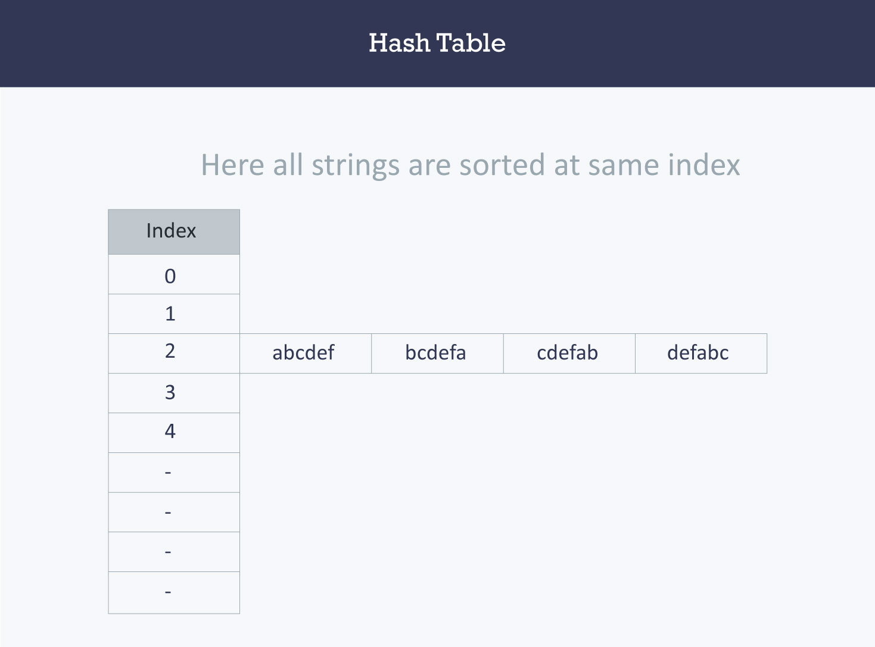
Hash Collisions : Chaining
https://www.hackerearth.com/practice/data-structures/hash-tables/basics-of-hash-tables/tutorial/

Slide 24
Hash Collisions: Chaining
Disadvantages
Parts of the array might never be used
As chains get longer, search time increases to O(n) in the worst case
Constructing new chain nodes is relatively expensive (still constant time, but the constant is high)
Is there a way to use the “unused” space in the array instead of using chains to make more space?

Slide 25
Hash Collisions: Linear probing
Open addressing
Find another open slot to hold the item that caused the collision.
Start at the original hash value position and move in a sequential manner through the slots until find the first slot that is empty
If the hash table is not full - to store key in the next array element
(key+1)%SIZE, (key+2)%SIZE, (key+3)%SIZE …
Note: go through circularly to cover the entire hash table

Slide 26
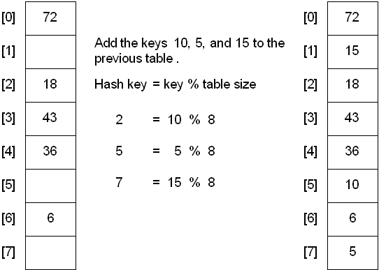
Hash Collisions: Linear probing

Slide 27
Hash Collisions : Linear probing
Primary clustering
A disadvantage to linear probing is the tendency for clustering; items become clustered in the table.
This means that if many collisions occur at the same hash value, a number of surrounding slots will be filled by the linear probing resolution

Slide 28
Hash Collisions : Quadratic Probing
If the hash table is not full move i² spots from the point of collision, where i is the number of attempts to resolve the collision.
(key+1²)%SIZE, (key+2²)%SIZE, (key+3²)%SIZE …

Slide 29
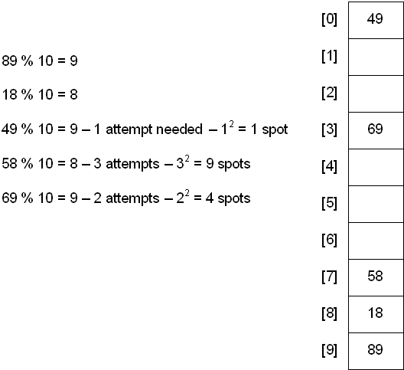
Hash Collisions : Quadratic Probing
49
12 % 10 = 2
12
69
58

Slide 30
Hash Collisions : Quadratic Probing
Limitation
At most half of the table can be used as alternative locations to resolve collisions
Secondary clustering
elements that hash to the same hash key will always probe the same alternative cells

Slide 31
Hash Collisions : Double Hashing
Applying a second hash function to the key when a collision occurs
Requirements for the second function:
it must never evaluate to 0
must make sure that all cells can be probed
Hash₂(key) = R - ( key % R )
where R is a prime number that is smaller than the size of the table
Attempt to store key in array elements
(t+d)%SIZE, (t+2d)%SIZE, (t+3d)%SIZE …

Slide 32
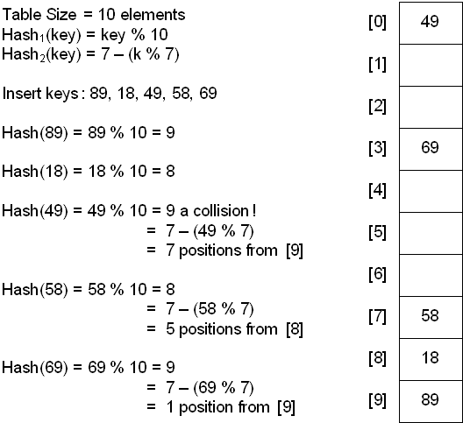
Hash Collisions : Double Hashing
69
(key % 7)
58
Insert in position
(9 + 7) % 10 = 6
49

Slide 33
Hash : Rehashing
Once the hash table gets too full, the running time for operations will start to take too long and may fail
A table at least twice the size of the original will be built and the elements will be transferred to the new table
The new size of the hash table:
should also be prime (smallest prime > 2 * old table size)
will be used to calculate the new insertion spot

Slide 34
Hash : Rehashing
Very expensive operation
O(N)
N elements to rehash and the table size is roughly 2N
When should the rehashing be applied?
once the table becomes half full
once an insertion fails
once a specific load factor has been reached
load factor is the ratio of the number of elements in the hash table to the table size

Slide 35
Hash & BST
BST HashTable
Average Speed O(log2N) O(1)
Find Min/Max Yes No
Items in a range Yes No
Sorted Input Very Bad No problems
Use HashTable if there is any suspicion of SORTED input & NO ordering information is required

Slide 36
Hash Applications
Associative arrays:
many types of in-memory tables
associative arrays (arrays whose indices are arbitrary strings or other complicated objects)
Database indexing:
Hash tables may also be used as disk-based data structures and database indices (such as in dbm)

Slide 37
Hash Applications
Caches: Hash tables can be used to implement caches
auxiliary data tables that are used to speed up the access to data, which is primarily stored in slower media
Object representation:
Several dynamic languages, such as Perl, Python, JavaScript, and Ruby use hash tables to implement objects.
Hash Functions are used in various algorithms to make their computing faster

Slide 38
Hash Example
x = 25, 129, 35, 2501, 47, 36
f(x) = x % 15 = 10 9 5 11 2 6
What happens when you try to insert: x = 65 ?
x = 65
f(x) = 5 collision
0 | 1 | 2 | 3 | 4 | 5 | 6 | 7 | 8 | 9 | 10 | 11 | 12 | 13 | 14
 |  | 47 |  |  | 35 | 36 |  |  | 129 | 25 | 2501

Slide 39
Hash Example: Chaining
x = 25, 129, 35, 2501, 47, 36, 65, 29, 16, 14, 99, 127 f(x) =10 9 5 11 2 6 5
0 | 1 | 2 | 3 | 4 | 5 | 6 | 7 | 8 | 9 | 10 | 11 | 12 | 13 | 14
 |  | ↓ |  |  | ↓ | ↓ | ↓ |  | ↓ | ↓ | ↓ |  |  | ↓
 |  | 47 |  |  | 65 | 36 | 127 |  | 99 | 25 | 2501 |  |  | 14
 |  |  |  |  | ↓ |  |  |  | ↓ |  |  |  |  | ↓
 |  |  |  |  | 35 |  |  |  | 129 |  |  |  |  | 29

Slide 40
Hash Example: Linear Probing
x = 25, 129, 35, 2501, 47, 36, 65
f(x) = x % 15 = 10 9 5 11 2 6 5
0 | 1 | 2 | 3 | 4 | 5 | 6 | 7 | 8 | 9 | 10 | 11 | 12 | 13 | 14
 |  | 47 |  |  | 35 | 36 | 65 |  | 129 | 25 | 2501
 |  |  |  |  | ↑ | ↑ | ↑
attempts

Slide 41
Hash Example: Linear Probing
x = 25, 129, 35, 2501, 47, 36, 65, 29
f(x) = x % 15 = 10 9 5 11 2 6 5
0 | 1 | 2 | 3 | 4 | 5 | 6 | 7 | 8 | 9 | 10 | 11 | 12 | 13 | 14
 |  | 47 |  |  | 35 | 36 | 65 |  | 129 | 25 | 2501 |  |  | 29
 |  |  |  |  |  |  |  |  |  |  |  |  |  | ↑
attempt

Slide 42
Hash Example: Linear Probing
x = 25, 129, 35, 2501, 47, 36, 65, 29, 16
0 | 1 | 2 | 3 | 4 | 5 | 6 | 7 | 8 | 9 | 10 | 11 | 12 | 13 | 14
 | 16 | 47 |  |  | 35 | 36 | 65 |  | 129 | 25 | 2501 |  |  | 29
 | ↑
attempt

Slide 43
Hash Example: Linear Probing
x = 25, 129, 35, 2501, 47, 36, 65, 29, 16, 14
0 | 1 | 2 | 3 | 4 | 5 | 6 | 7 | 8 | 9 | 10 | 11 | 12 | 13 | 14
14 | 16 | 47 |  |  | 35 | 36 | 65 |  | 129 | 25 | 2501 |  |  | 29
↑ |  |  |  |  |  |  |  |  |  |  |  |  |  | ↑
attempt
attempt

Slide 44
Hash Example: Linear Probing
x = 25, 129, 35, 2501, 47, 36, 65, 29, 16, 14, 99
0 | 1 | 2 | 3 | 4 | 5 | 6 | 7 | 8 | 9 | 10 | 11 | 12 | 13 | 14
14 | 16 | 47 |  |  | 35 | 36 | 65 |  | 129 | 25 | 2501 | 99 |  | 29
 |  |  |  |  |  |  |  |  | ↑ | ↑ | ↑ | ↑
attempts

Slide 45
Hash Example: Linear Probing
x = 25, 129, 35, 2501, 47, 36, 65, 29, 16, 14, 99, 127
0 | 1 | 2 | 3 | 4 | 5 | 6 | 7 | 8 | 9 | 10 | 11 | 12 | 13 | 14
14 | 16 | 47 |  |  | 35 | 36 | 65 | 127 | 129 | 25 | 2501 | 99 |  | 29
 |  |  |  |  |  |  | ↑ | ↑
attempts

Slide 46
Hash Example: Quadratic Probing
x = 25, 129, 35, 2501, 47, 36, 65
f(x) = t =x % 15 = 10 9 5 11 2 6 5
0 | 1 | 2 | 3 | 4 | 5 | 6 | 7 | 8 | 9 | 10 | 11 | 12 | 13 | 14
 |  | 47 |  |  | 35 | 36 |  |  | 129 | 25 | 2501 |  |  | 65
 |  |  |  |  | ↑ | ↑ |  |  | ↑ |  |  |  |  | ↑
 |  |  |  |  | t | t+1 |  |  | t+4 |  |  |  |  | t+9
attempts

Slide 47
Hash Example: Quadratic Probing
x = 25, 129, 35, 2501, 47, 36, 65, 29
f(x) = 10 9 5 11 2 6 5
0 | 1 | 2 | 3 | 4 | 5 | 6 | 7 | 8 | 9 | 10 | 11 | 12 | 13 | 14
29 |  | 47 |  |  | 35 | 36 |  |  | 129 | 25 | 2501 |  |  | 65
↑ |  |  |  |  |  |  |  |  |  |  |  |  |  | ↑
t+1 |  |  |  |  |  |  |  |  |  |  |  |  |  | t
attempt
attempt

Slide 48
Hash Example: Quadratic Probing
x = 25, 129, 35, 2501, 47, 36, 65, 29, 16
0 | 1 | 2 | 3 | 4 | 5 | 6 | 7 | 8 | 9 | 10 | 11 | 12 | 13 | 14
29 | 16 | 47 |  |  | 35 | 36 | 65 |  | 129 | 25 | 2501 |  |  | 29
 | ↑
 | t
attempt

Slide 49
Hash Example: Quadratic Probing
x = 25, 129, 35, 2501, 47, 36, 65, 29, 16, 14
0 | 1 | 2 | 3 | 4 | 5 | 6 | 7 | 8 | 9 | 10 | 11 | 12 | 13 | 14
29 | 16 | 47 | 14 |  | 35 | 36 | 65 |  | 129 | 25 | 2501 |  |  | 29
↑ |  |  | ↑ |  |  |  |  |  |  |  |  |  |  | ↑
t+1 |  |  | t+4 |  |  |  |  |  |  |  |  |  |  | t
attempts
attempt

Slide 50
Hash Example: Quadratic Probing
x = 25, 129, 35, 2501, 47, 36, 65, 29, 16, 14, 99
0 | 1 | 2 | 3 | 4 | 5 | 6 | 7 | 8 | 9 | 10 | 11 | 12 | 13 | 14
29 | 16 | 47 | 14 |  | 35 | 36 |  |  | 129 | 25 | 2501 |  | 99 | 65
 |  |  |  |  |  |  |  |  | ↑ | ↑ |  |  | ↑
 |  |  |  |  |  |  |  |  | t | t+1 |  |  | t+4
attempts

Slide 51
Hash Example: Quadratic Probing
x = 25, 129, 35, 2501, 47, 36, 65, 29, 16, 14, 99, 127
0 | 1 | 2 | 3 | 4 | 5 | 6 | 7 | 8 | 9 | 10 | 11 | 12 | 13 | 14
29 | 16 | 47 | 14 |  | 35 | 36 | 127 |  | 129 | 25 | 2501 |  | 99 | 65
 |  |  |  |  |  |  | ↑
 |  |  |  |  |  |  | t
attempt

Slide 52
Hash Example: Double Hashing
x = 25, 129, 35, 2501, 47, 36, 65
f₁(x) = t = x % 15 = 10 9 5 11 2 6 5
f₂(x) = d = 11 − x % 11 = 1
0 | 1 | 2 | 3 | 4 | 5 | 6 | 7 | 8 | 9 | 10 | 11 | 12 | 13 | 14
 |  | 47 |  |  | 35 | 36 | 65 |  | 129 | 25 | 2501
 |  |  |  |  | ↑ | ↑ | ↑
 |  |  |  |  | t | t+1 | t+2
attempts

Slide 53
Hash Example: Double Hashing
x = 25, 129, 35, 2501, 47, 36, 65, 29
f₁(x) = t = 10 9 5 11 2 6 5 14
f₂(x) = d = 4
0 | 1 | 2 | 3 | 4 | 5 | 6 | 7 | 8 | 9 | 10 | 11 | 12 | 13 | 14
 |  | 47 |  |  | 35 | 36 |  |  | 129 | 25 | 2501 |  |  | 29
 |  |  |  |  |  |  |  |  |  |  |  |  |  | ↑
 |  |  |  |  |  |  |  |  |  |  |  |  |  | t
attempt

Slide 54
Hash Example: Double Hashing
x = 25, 129, 35, 2501, 47, 36, 65, 29, 16
f₁(x) = t = 10 9 5 11 2 6 5 14 1
f₂(x) = d = 6
0 | 1 | 2 | 3 | 4 | 5 | 6 | 7 | 8 | 9 | 10 | 11 | 12 | 13 | 14
29 | 16 | 47 |  |  | 35 | 36 | 65 |  | 129 | 25 | 2501 |  |  | 29
 | ↑
 | t
attempt

Slide 55
Hash Example: Double Hashing
x = 25, 129, 35, 2501, 47, 36, 65, 29, 16, 14
f₁(x) = t = 10 9 5 11 2 6 5 14 1 14
f₂(x) = d = 8
0 | 1 | 2 | 3 | 4 | 5 | 6 | 7 | 8 | 9 | 10 | 11 | 12 | 13 | 14
14 | 16 | 47 |  |  | 35 | 36 | 65 |  | 129 | 25 | 2501 |  |  | 29
↑ |  |  |  |  |  |  | ↑ |  |  |  |  |  |  | ↑
t+16 |  |  |  |  |  |  | t+8 |  |  |  |  |  |  | t
attempts
attempt

Slide 56
Hash Example: Double Hashing
x = 25, 129, 35, 2501, 47, 36, 65, 29, 16, 14, 99
f₁(x) = t = 10 9 5 11 2 6 5 14 1 14 9
f₂(x) = d = 11
0 | 1 | 2 | 3 | 4 | 5 | 6 | 7 | 8 | 9 | 10 | 11 | 12 | 13 | 14
14 | 16 | 47 |  |  | 35 | 36 | 65 |  | 129 | 25 | 2501 | 99 |  | 29
 | ↑ |  |  |  | ↑ |  |  |  | ↑ |  |  | ↑
 | t+22 |  |  |  | t+11 |  |  |  | t |  |  | t+33
attempts

Slide 57
Hash Example: Double Hashing
x = 25, 129, 35, 2501, 47, 36, 65, 29, 16, 14, 99, 127
f₁(x) = 10 9 5 11 2 6 5 14 1 14 9 7
f₂(x) = 5
Infinite loop!
0 | 1 | 2 | 3 | 4 | 5 | 6 | 7 | 8 | 9 | 10 | 11 | 12 | 13 | 14
14 | 16 | 47 |  |  | 35 | 36 | 65 |  | 129 | 25 | 2501 | 99 |  | 29
 |  | ↑ |  |  |  |  | ↑ |  |  |  |  | ↑
 |  | t+10 |  |  |  |  | t |  |  |  |  | t +5
attempts

